Slide 1
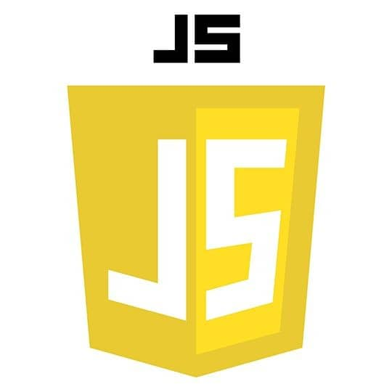
JavaScript Overview
What javascript
Internal &External javascript
Variables
Manipulating HTML Content with JavaScript
Arrays
If statement
Js fuction
Js operators

Slide 2
What is JavaScript
JavaScript is a modern programming language used to make web pages interactive
History of JavaScript:It was first created in 1995 by Brendan Eich while working at a company called Netscape.At first, it was called Mocha and LiveScript before finally being renamed to JavaScript.
How JavaScript Works:
It runs directly inside web browsers like Chrome, Firefox. It can change and update HTML and CSS on a website to create new and interactive features.
Common Uses of JavaScript:
Animations: Making websites look cool and interactive with moving visuals.
Form Validation: Checking if the information users enter in forms is correct before submitting.
Dynamic Content: Creating interactive buttons and menus

Slide 3
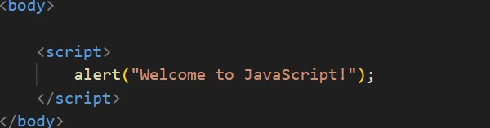
Internal and external JS
JavaScript can be written inside an HTML file using the <script> tag within the <head>or <body>.
Example:
<script> alert("Welcome to JavaScript!");
</script>
External javascript:javascript code written in separate file with .js extension
<script src=“main.js”></script>
.

Slide 4
JS Variables
A variables is a container for storing data values. It allows you to save, update, and reuse data in your program.
JavaScript Variables can be declared in 3 ways
1. var :canbe redeclared and updated
2. let :can be updated but not redeclared within the same scope
3. const : can’t be updated or redeclared; its constant and read only
Declaring variables:
var name = "John"; // Using var
let age = 25; // Using let
Const num = 3.14; // Using const

Slide 5
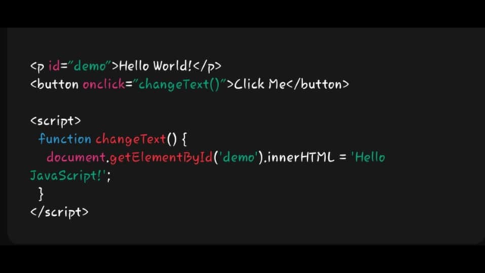
Manipulating HTML Content with JavaScript
JavaScript can dynamically modify the content and style of HTML elements using various methods.
Changing HTML Content:
Method: getElementById() - Targets an element by its ID and changes its content.
Example:
document.getElementById("demo").innerHTML = "Hello JavaScript!";
Changing HTML Styles (CSS):
javaScript can also change the styling of HTML elements.
document.getElementById("demo").style.fontSize = "35px";
.

Slide 6
JS Array
Array is a special variable that can hold multiple values in a single variable.
Arrays are used to store lists of data, such as numbers, strings, or objects.
You can declare an arrey using:
let fruits = ["banana", "apple", "mango", "orange", "grape"];
// Displaying all items in the array console.log(fruits);
// Accessing a specific item in the array (e.g., "mango")
console.log(fruits[2]);
Adding new items to the arrayfruits.push("pineapple");
console.log(fruits);
// This will add "pineapple" to the end of the array
// Removing an item from the array (e.g., "banana") fruits.splice(0, 1);
console.log(fruits);

Slide 7
If statement
An if statement is a way to make decisions in JavaScript. It allows you to run code only if a
certain condition is true.
let age = 18;if (age >= 18) {
console.log("You are allowed to vote."); }
Else if statement (multiple condition)
Let score = 75;I
if (score >= 90) { console.log("Grade: A");} else if (score >= 80) {
console.log("Grade: B");}
else I f (score >= 70) {
console.log("Grade: C");}
else {
console.log("Grade: F");}

Slide 8
Js functions
Js function is a block of code in javascript created to perform a specific tasks and
Can be reused
Function Declaration.
function greet(name) {
console.log("Hello, " + name+”!”);}
greet(“Sumaya"); // Output: Hello, Sumaya!
Explanation of code:
function: The keyword used to define a function.
greet: The name of the function.
(name): The data the function receives (parameter).
console.log(): Displays the output.

Slide 9
JS Operators
JavaScript operators are symbols used to perform different operations like :Arithmetic, Comparison,
Assignment, and Logical operations.
Types of JavaScript Operators:
Arithmetic Operators (Math Operations):---
Examples: +, -, *, /, % (modulus), ++ (increment), -- (decrement).
Assignment Operators (Assigning Values):---
Examples: =, +=, -=, *=, /=, %=.
Comparison Operators (Comparing Values):
Examples: ==, ===, !=, !==, >, <, >=, <=.
Logical Operators (Logic Operations):
Examples: && (AND), || (OR), ! (NOT).
Operators are assential for building complex logic in programming
.

Slide 10
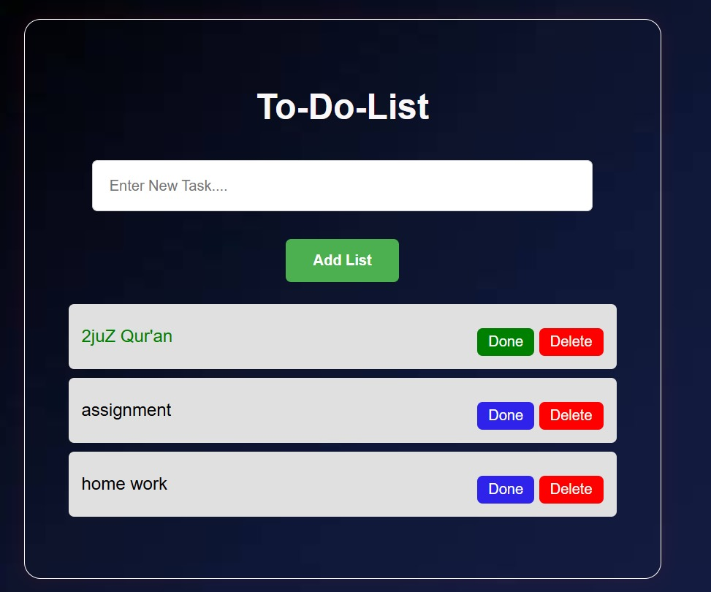
To-Do-List project
To-Do List project is a simple web application where users can add, mark as completed, and delete tasks. It helps in task management and productivity improvement.

Slide 11
Thank you for Listening! 😍

